Slide 1
Lecture 3 Neural Networks: MLP & Some Important Notes
CS582
Machine Learning: Getting Computers
to Program Themselves
“Discovering the Learning Dynamics of the Laws of Nature”
Dr. Emdad Khan
ekhan@miu.edu
Dept. of Computer Science
Maharishi International University

Slide 2
Multi-Layer Networks
McCulloch and Pitts based Perceptron introduced in 1949 was a great achievement which can model any linear problem.
Unfortunately majority of the interesting practical problems are nonlinear problems (e.g. XOR we have covered).
Multi-layer networks can represent arbitrary functions (linear or nonlinear).
However, an effective learning algorithm for such networks was thought to be difficult.
In fact, it took over 30 years to develop learning algorithms for multi-layer NN.

Slide 3
Multi-Layer Networks
A typical multi-layer network consists of an input, hidden and output layer, each fully connected to the next, with activation feeding forward.
The weights determine the function computed. Given an arbitrary number of hidden units, any Boolean function can be computed with a single hidden layer.
output
hidden
input

Slide 4
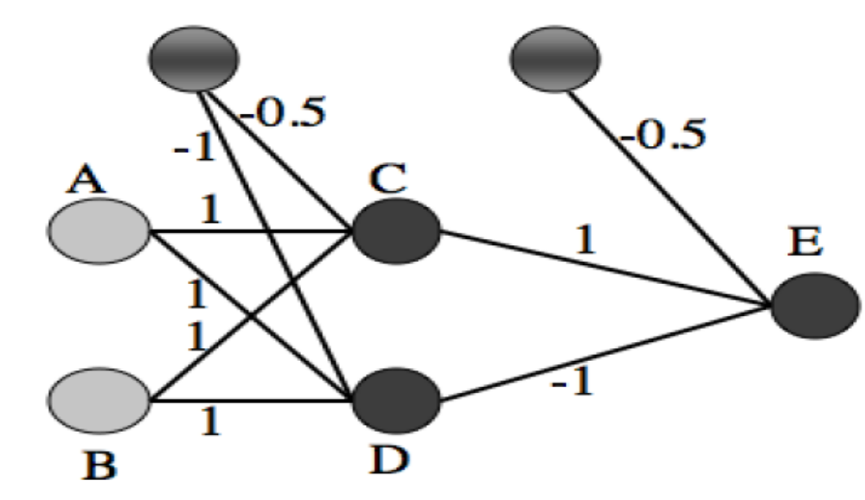
MLP Network Solving XOR
MLP (Multi Layer Perceptron) Network can solve the XOR Problem.
MLP is the most commonly used NN.

Slide 5
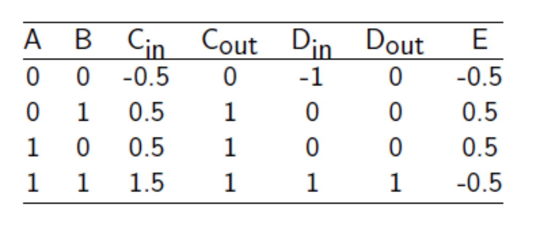
MLP Network Solving XOR
MLP (Multi Layer Perceptron) Network can solve the XOR Problem.

Slide 6
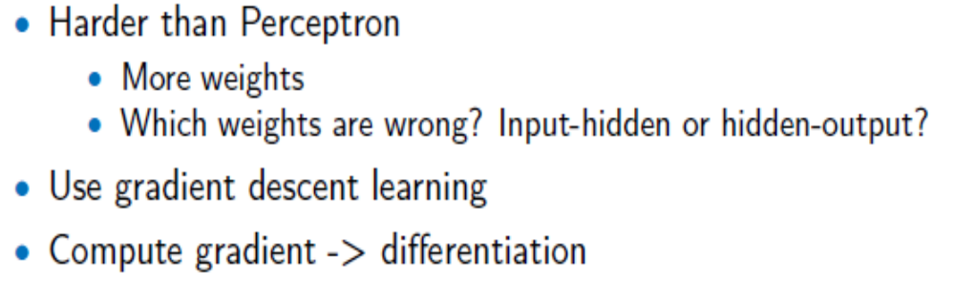
Gradient Descent
We have seen that MLP can solve XOR.
But how do we deal with hidden layer, change the weights etc?

Slide 7
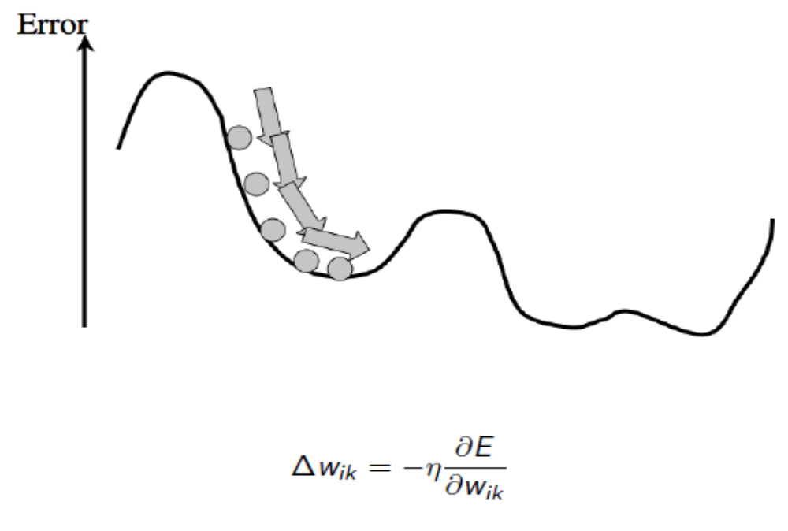
Gradient Descent & Delta Learning Rule
The delta rule is a gradient descent learning rule for updating the weights of the inputs to artificial neurons in a single-layer neural network

Slide 8
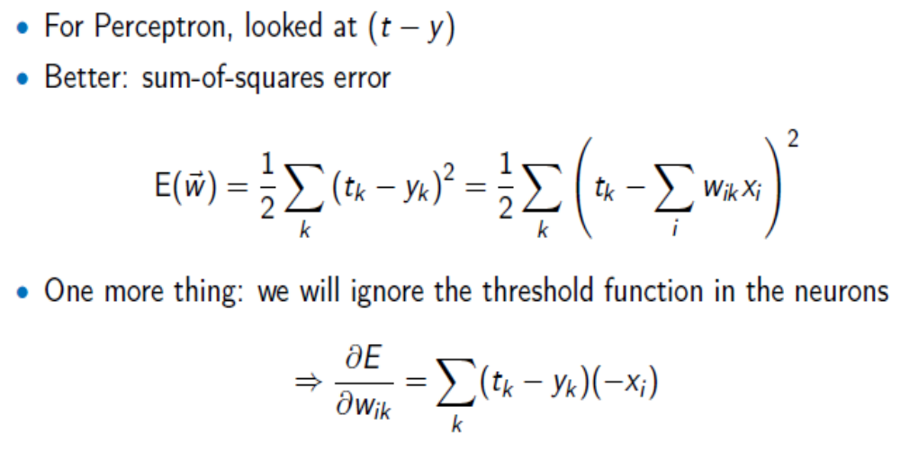
MLP Learning
So, we need an Error Function and then need to differentiate it

Slide 9
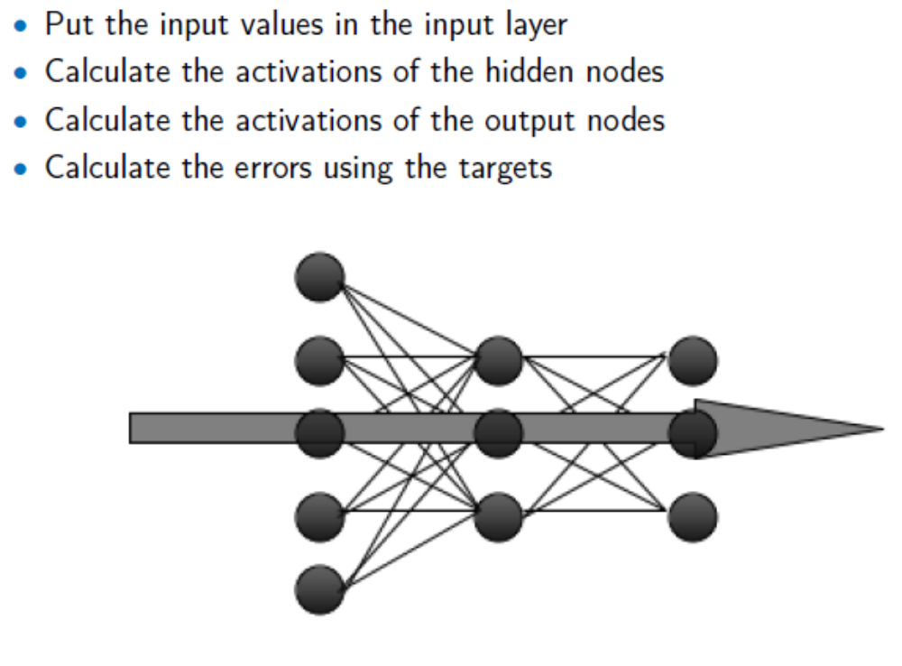
Training MLPs 1: Forward

Slide 10
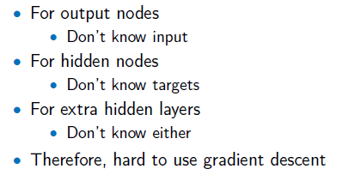
Training MLPs: The Problem

Slide 11
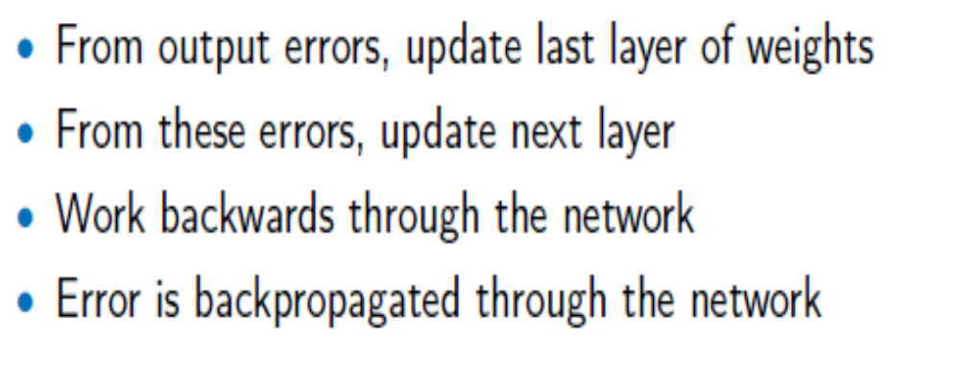
Backpropagation of Errors
More Later

Slide 12
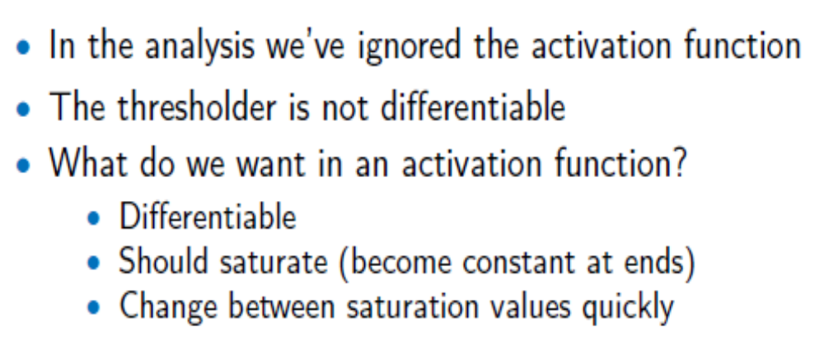
Activation Function

Slide 13
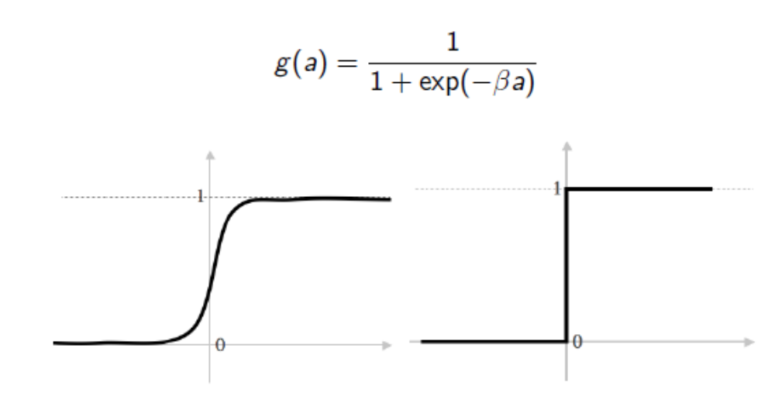
The Sigmoid Activation Function

Slide 14
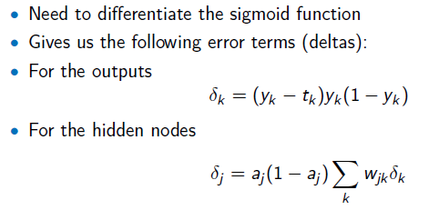
Error Term (delta) Using Differentiation
For now we are just showing the Deltas. We will prove these after a few slides

Slide 15
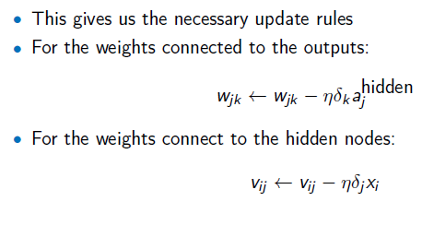
Weight Update Rules
Like Deltas, we are just showing the weight update rules. We will prove these after a few slides

Slide 16

MLP Algorithm
1. Do a Forward pass
2. Do a Backward pass as shown below:
compute the error at the output using:
·
compute the error in the hidden layer(s) using:
· update the output layer weights using:
· update the hidden layer weights using:
3. Repeat until learning is over

Slide 17
Concept of Back Propagation (New Slide)
1. We know the equivalent error at the output layer (eqn. 4.8) i.e.
2. We need to create an equivalent error at the hidden layer based on the equivalent error at the output layer. To do so, we need to send back the error to all hidden layer units scaled by the corresponding weights between the hidden layer and output layer, and sum all errors (see the diagram and eqn. 4.9 below).
∑ x y_{k}
Input Hidden Output
Due to sigmoid Total backpropagated error from output layer

Slide 18
Weight updates Using Backpropagated Errors
3. The equivalent error at the output layer neurons are used to update the weights between the hidden layer and the output layer (eqn. 4.10):
4. The equivalent error at the hidden layer neurons are used to update the weights between the input layer and the hidden layer (eqn. 4.11):
Due to sigmoid Total backpropagated error from output layer

Slide 19
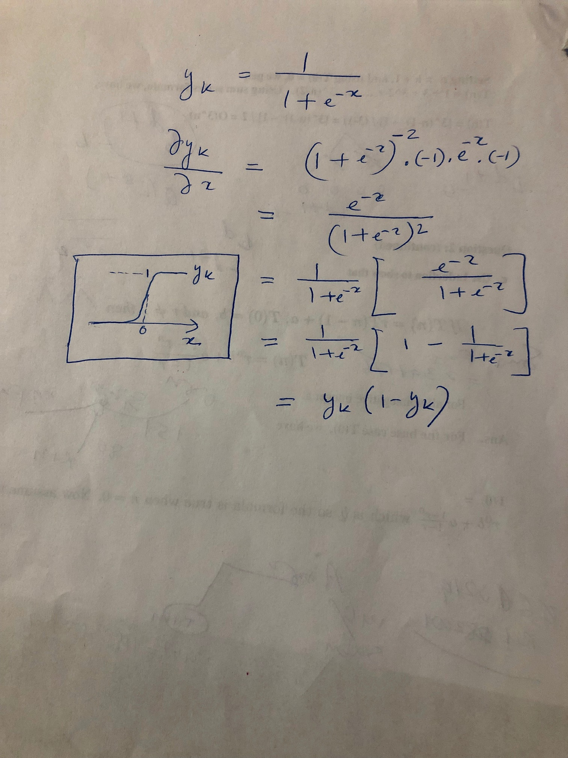
Derivative of the Sigmoid (New Slide)
Due to sigmoid Total backpropagated error from output layer

Slide 20
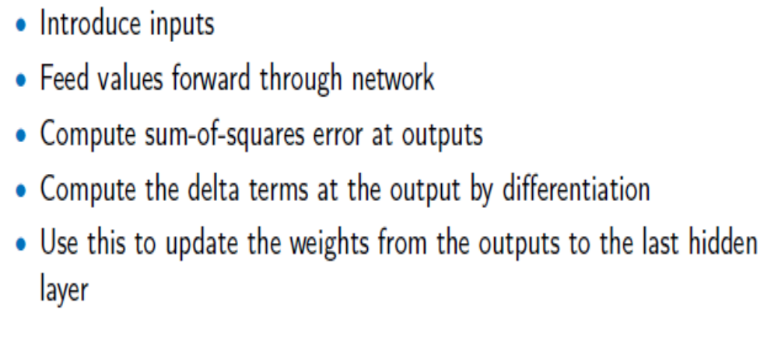
Summary of Backpropagation

Slide 21
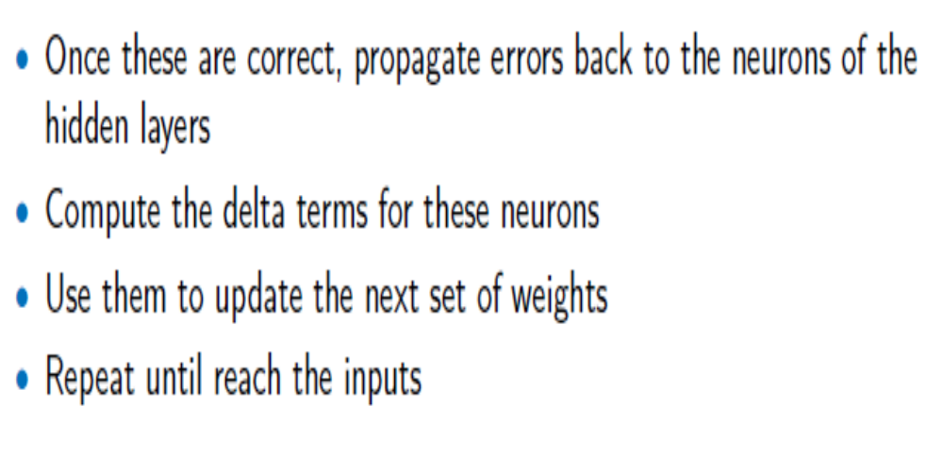
Summary of Backpropagation
Details of how to backpropagate errors will be shown next -

Slide 22
Backpropagation - Derivation
We have seen delta rule is a gradient descent learning rule for updating the weights of the inputs to artificial neurons in a single-layer neural network.
We will use Delta Rule to develop Generalized Delta Rule for Multi Layer NN with semi-linear Activation functions.
Will show how to send error backwards (Backpropagation) to calculate weights in the hidden layers.

Slide 23
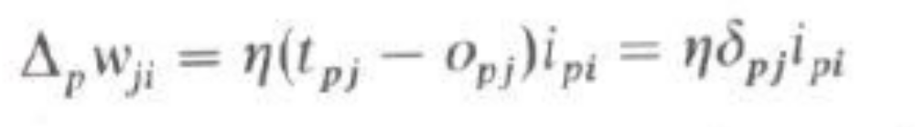
Backpropagation - Derivation
From the original paper by Rumelhart, Hinton and Williams (1986) – as their derivation & proof are simpler to understand.
Notations are a bit different – p means an input-output pair, t is “target value”, O is output value (previous ‘y’); i, j, k means i-th, -jth or k-th layer.
Starting with Standard Delta rule which is a gradient descent learning rule i.e.

Slide 24
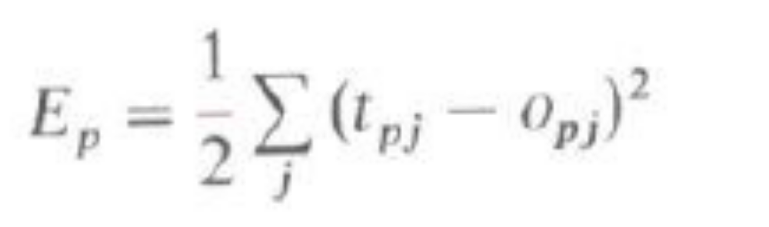
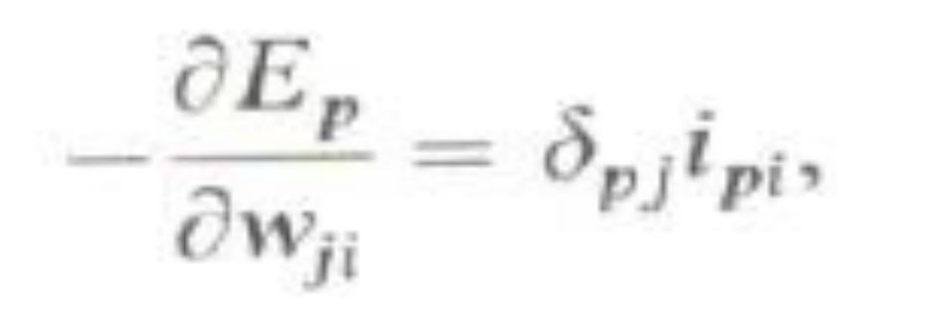
Backpropagation - Derivation
First, let’s prove the Delta Rule. Use Error E as shown below (Eqn. 2) and then prove the equation for the derivative of E with respect to weights (Eqn. 3). Ipi is the input of pattern p at layer i.

Slide 25
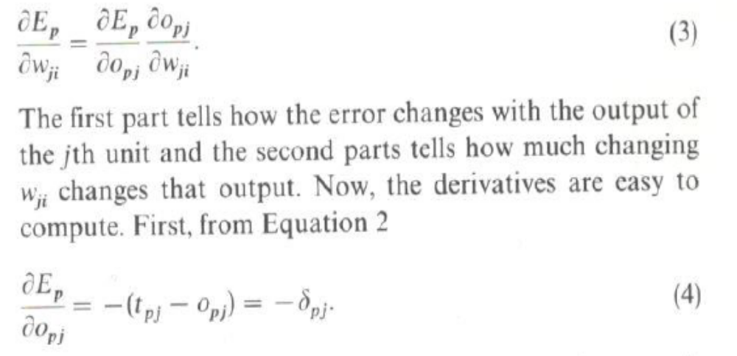
Using Chain Rule
Using Chain Rule of differentiation, we have,

Slide 26
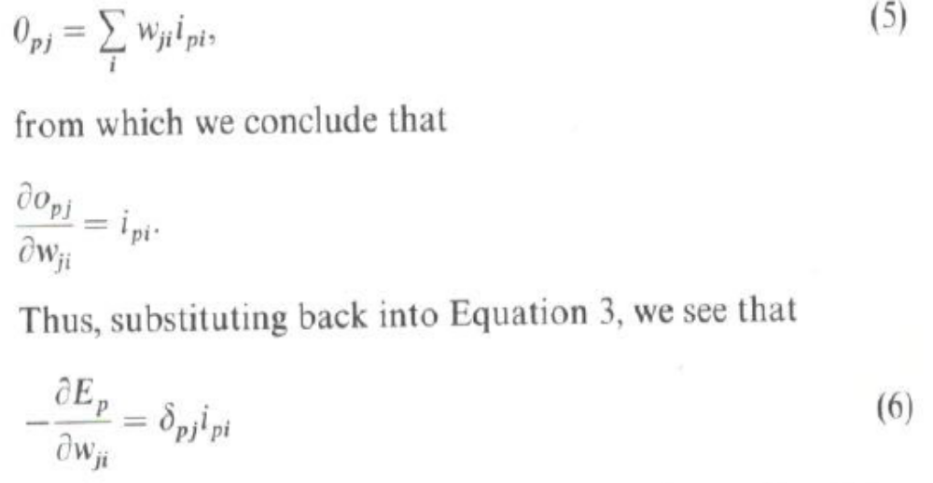
Using Chain Rule
Assuming linear units, we have the following where eqn. 6 proves the delta rule -

Slide 27
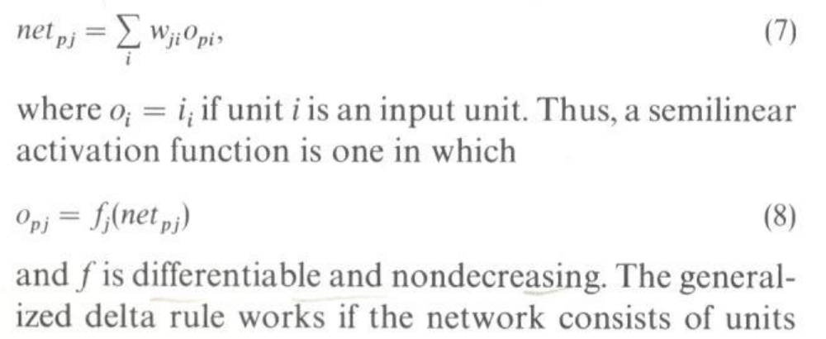
Delta Rule Using Semi-Linear Activation
Total output at j-th layer is,
having semi-linear activation function.

Slide 28
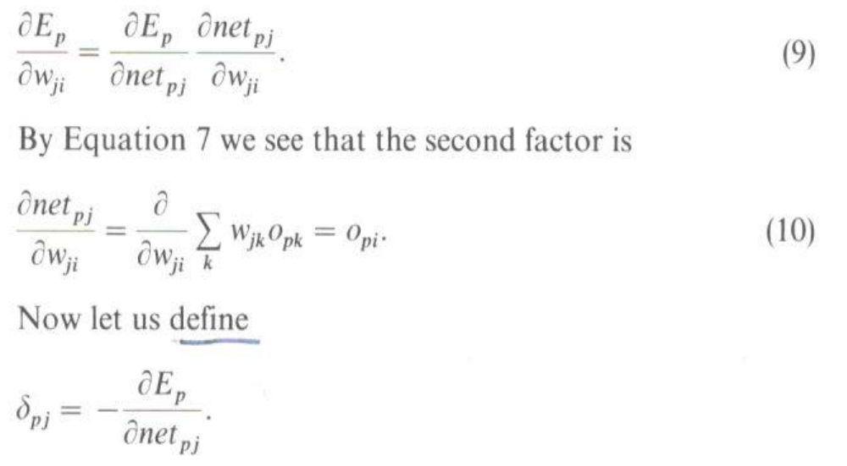
Backpropagation Equations -1
Using Chain Rule again, we have,

Slide 29
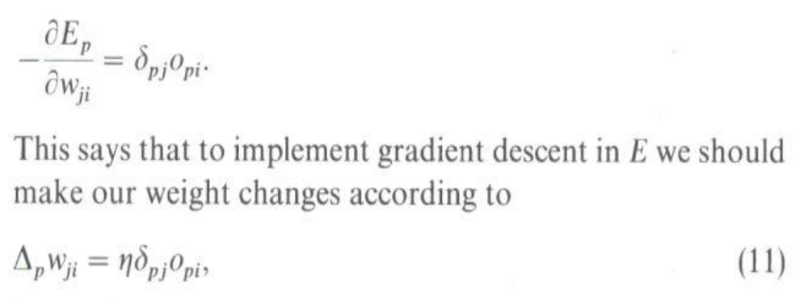
Backpropagation Equations - 2
Equation 9 (Generalized Delta Rule), thus has the equivalent form as shown for Standard Delta Rule.

Slide 30
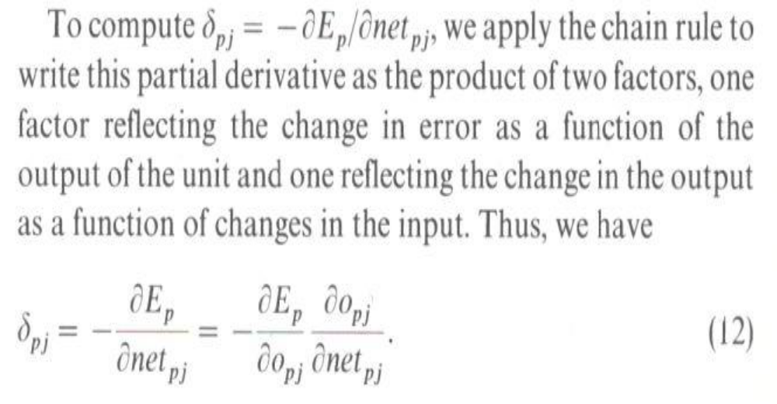
Backpropagation Equations - 3

Slide 31
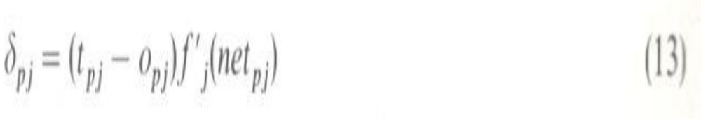
Backpropagation Equations - 4
The 2nd term in Eqn 12 [has 2 parts: 1st part is (t_{pj} - o_{pj} ) and 2nd part is f”(net_{pj})] becomes as follows for any unit in the output layer:
For any unit in a hidden layer, we use Chain Rule again BUT in this case we go backward and add all the contributions of errors from output layer to the hidden layer as shown in the next slide -

Slide 32
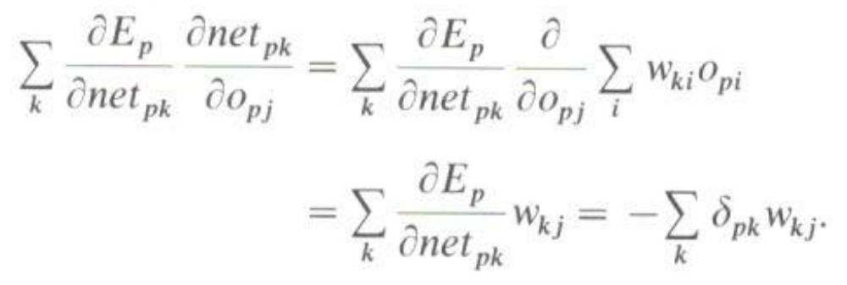
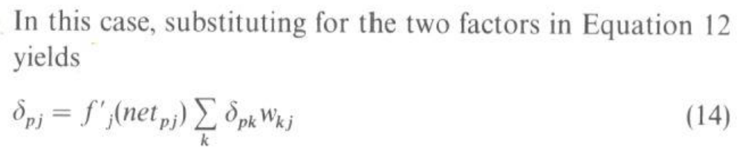
End of Backpropagation Equations
Note- in above, we are doing 1st part of the 2nd term in eqn. 12, dEp / dOpj. This is the term whose style changes from layer to layer.

Slide 33
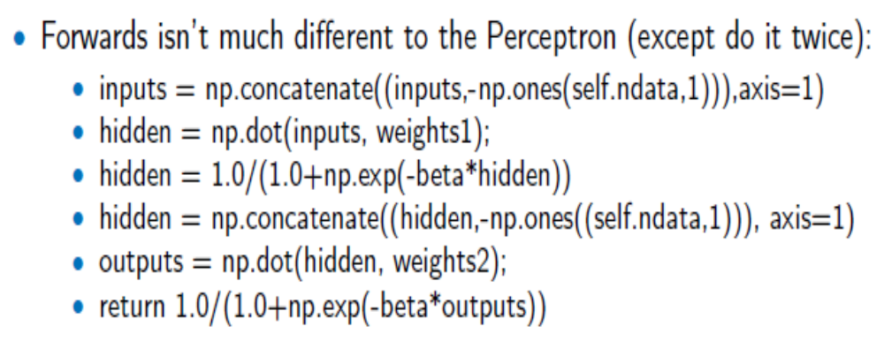
Implementation using Python

Slide 34
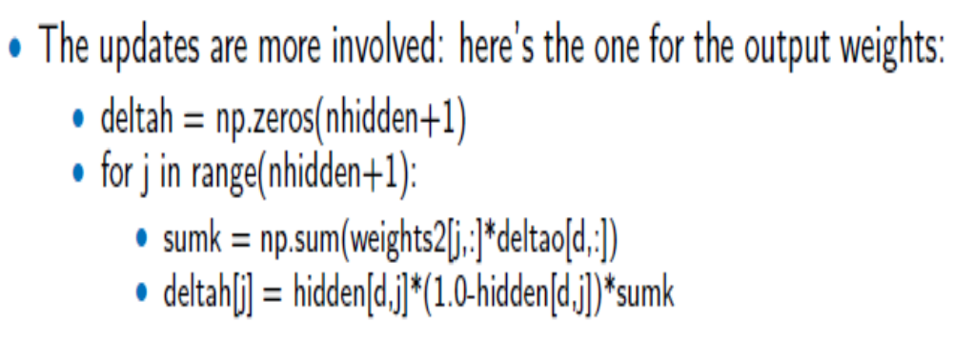
Implementation - Training

Slide 35
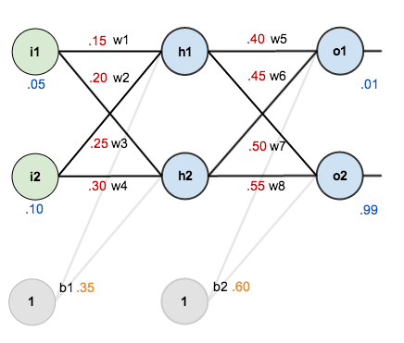
MLP Worked out Example with Back Propagation (New Slide)
From – Matt Mazur’s blog

Slide 36
MLP Worked out Example with Back Propagation – 2 (New Slide)
Forward pass, Backward pass, Weight updates etc:
https://mattmazur.com/2015/03/17/a-step-by-step-backpropagation-example/

Slide 37
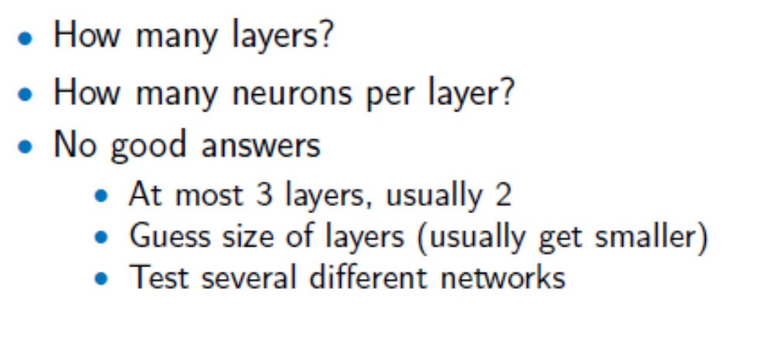
Network Topology
More on this later.

Slide 38
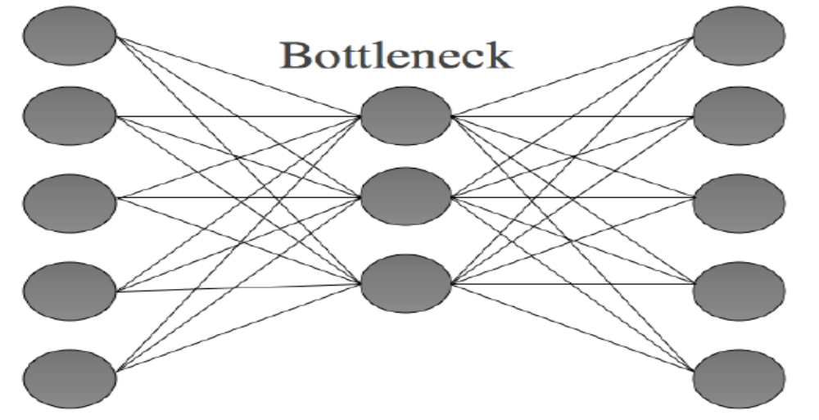
Applications
There are many applications – classification, prediction, logic, fraud detection, and many more.
We will focus on Data Compression – The Auto-Associative Network (Output is same as Input)

Slide 39
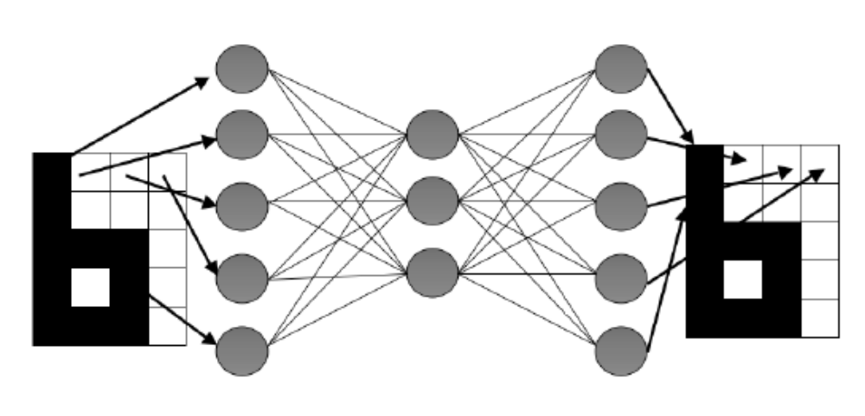
The Auto-Associative Network
Less number of hidden units forces compression and learns about the Input features.

Slide 40
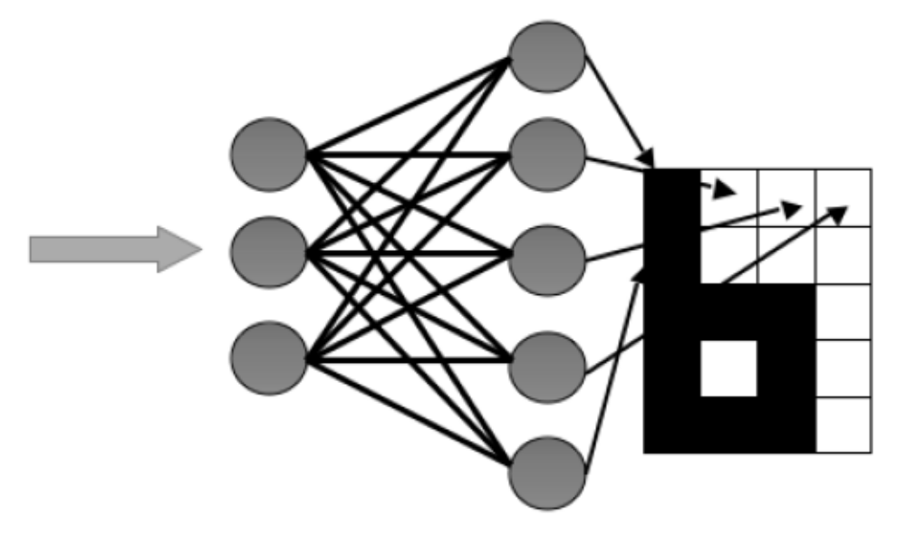
The Auto-Associative Network
Will use the Auto-Associative feature in Deep Learning later on.

Slide 41
Other Successful Applications
Text to Speech (NetTalk)
Fraud detection
Financial Applications
  HNC (eventually bought by Fair Isaac)
Chemical Plant Control
  Pavillion Technologies
Automated Vehicles
Game Playing
  Neurogammon
Handwriting recognition

Slide 42
Some Important Notes

Slide 43
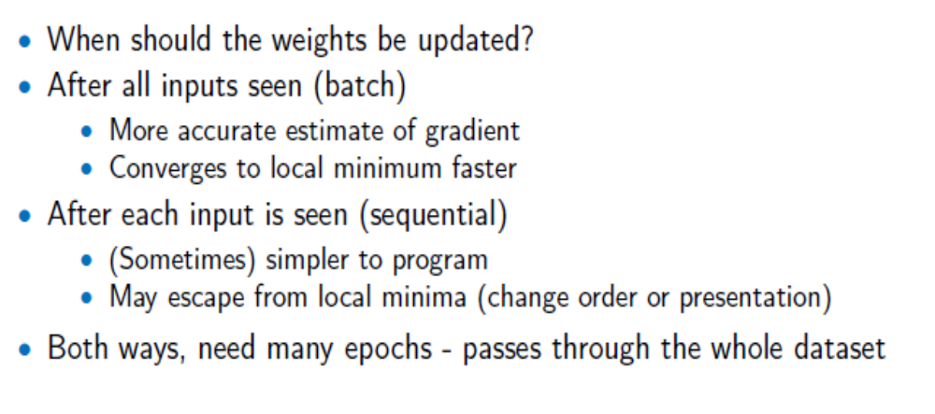
Batch and Sequential Learning

Slide 44
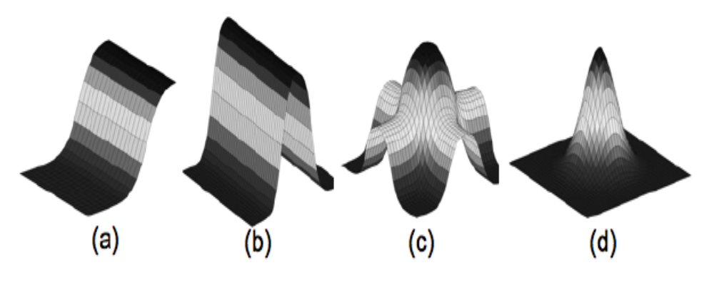
Learning Capacity - 1
FIGURE 4.9 The learning of the MLP can be shown as the output of a single sigmoidal neuron (a), which can be added to others, including reversed ones, to get a hill shape (b). Adding another hill at 90° produces a bump (c), which can be sharpened to any extent we want (d), with the bumps added together in the output layer. Thus the MLP learns a local representation of individual inputs.

Slide 45
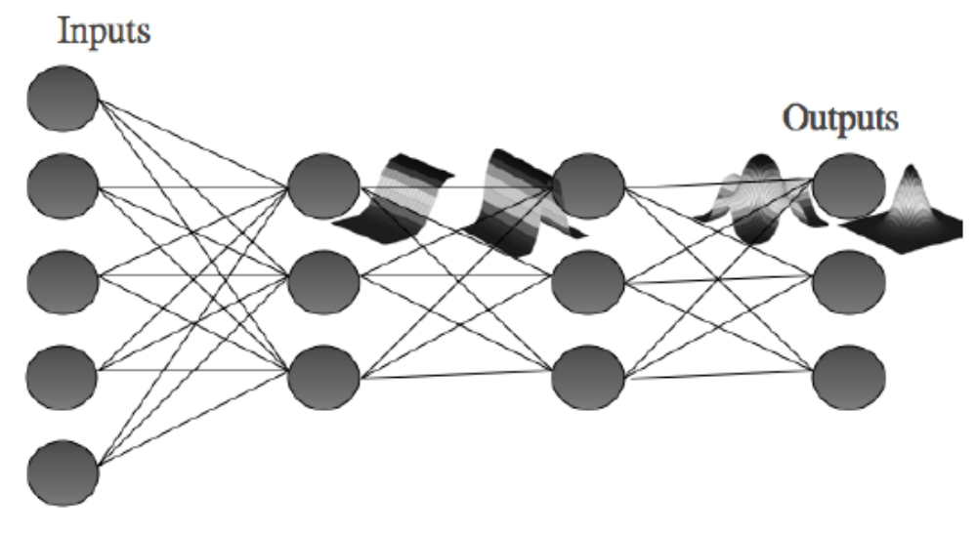
Learning Capacity - 2
FIGURE 4.10 Schematic of the effective learning shape at each stage of the MLP.

Slide 46
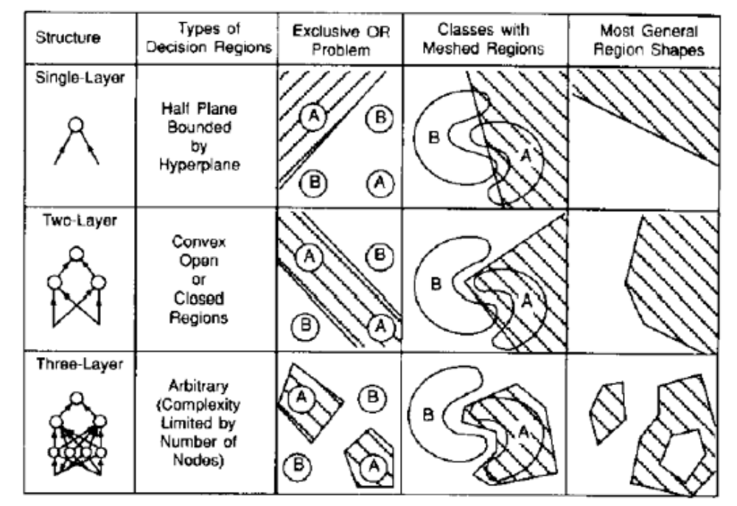
Decision Boundaries

Slide 47
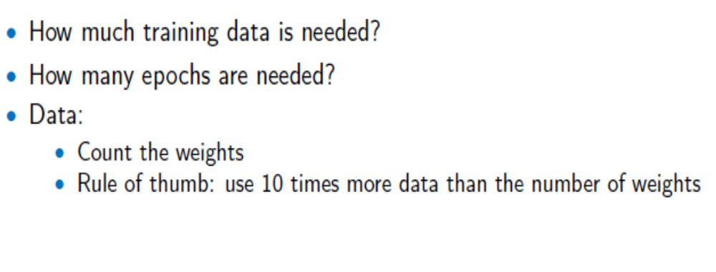
Amount of Training

Slide 48
Training, Validation and Testing
The training set is used to train a neural net. The error of this dataset is minimized during training (as we have seen and used).
The Validation set tries to keep track of how well NN is doing as it learns (i.e. checks whether learning algorithm works).
A test set is used to finally check the over all performance of a neural net.

Slide 49
Training, Validation and Testing
The exact number of training to testing to validation data is up to you and also depends on the application.
A good guideline is to use 50:25:25 if there are plenty of data; otherwise use 60:20:20 (Fig. 2.6).
If total data is really short, it is possible to use leave-some-out, multi-fold Cross Validation (Fig 2.7).

Slide 50
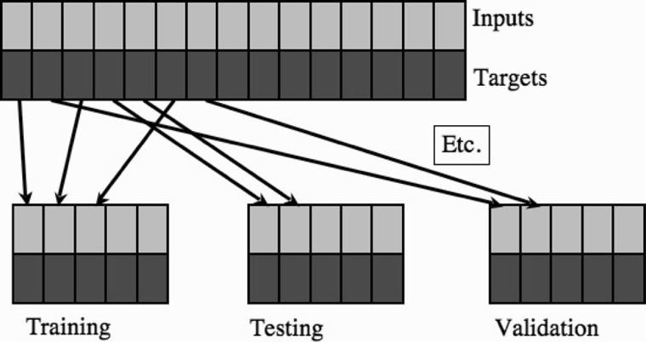
Validation when Enough Data
FIGURE 2.6 The dataset is split into different sets, some for training, some for validation, and some for testing.

Slide 51
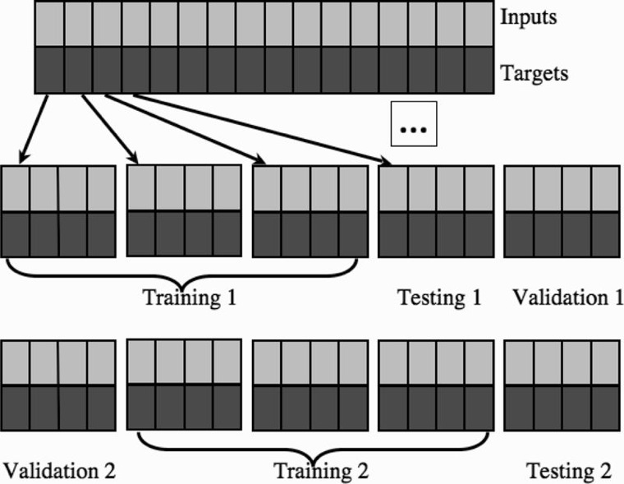
Validation when Limited Data (Fig. 2.7)

Slide 52
Validation when Limited Data
For FIGURE 2.7
Leave-some-out, multi-fold cross-validation uses many models.
Splits the data into sets, training a model on most sets and holding one out for validation (and another for testing).
Different models are trained with different sets being held out.
Finally, the model with lowest validation error is used.

Slide 53
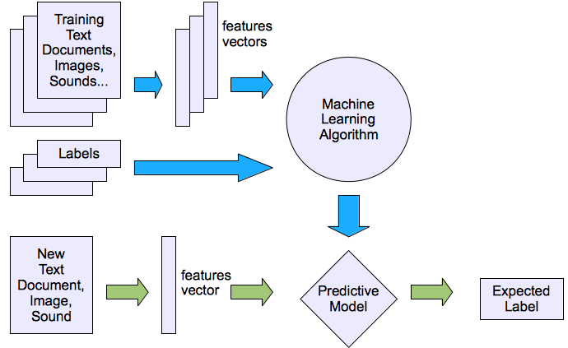
Machine learning structure (From Lecture #1 as quick review)
Supervised learning

Slide 54
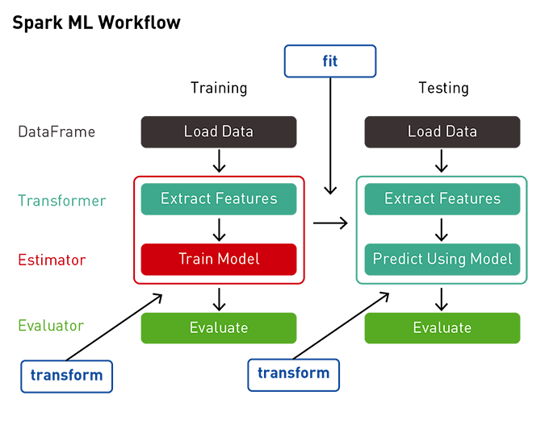
Typical Machine Learning Pipeline
Data collection, Data cleaning
Feature extraction (labelling and dimensionality reduction)
Model validation, Visualisation, more

Slide 55
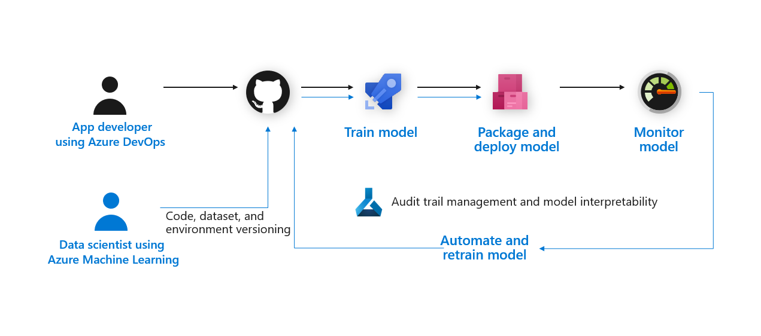
Machine Learning Pipeline – More Details

Slide 56
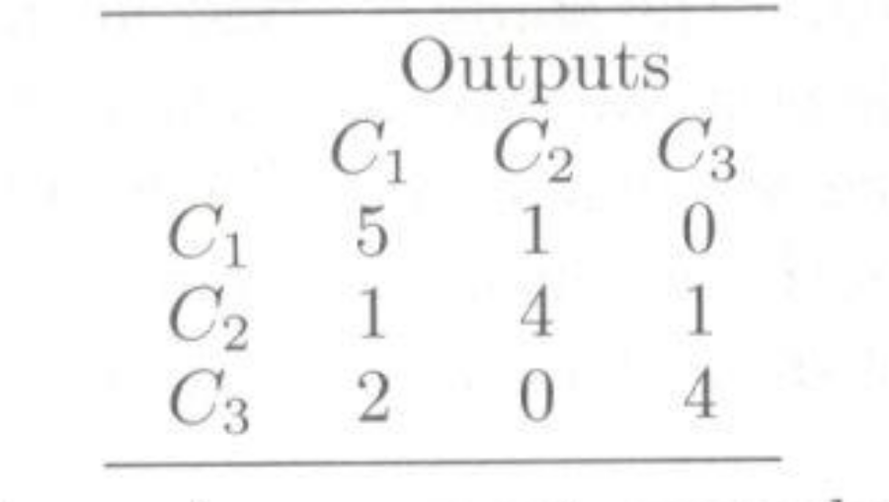
Confusion Matrix
Regardless of how much data we use to test, we still need to determine whether the result is good or not using some matrix
For classification problem we use Confusion Matrix (uses all possible classes in both horizontal & vertical directions; the top of the table shows predicted outputs) as shown below:

Slide 57
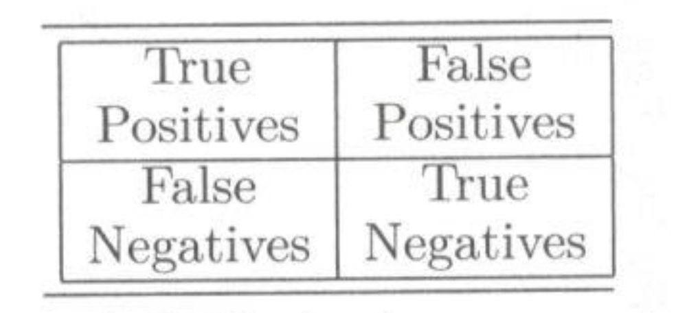
Accuracy Matrix
One good way to analyze results (other than using accuracy from the Confusion Matrix) is to use an Accuracy Matrix shown below:
and accuracy can now be defined as
Accuracy = (#TP + #TN) / (#TP + #FP + #TN + # #FN)

Slide 58
Other Key Parameters
Precision, Recall (Sensitivity) and F-1 Score.
F-1 Score is key for highly unbalanced dataset (accuracy is not a good representative for highly unbalanced dataset).

Slide 59
Generalization
One of the major advantages of neural nets is their ability to generalize.
This means that a trained net could classify data from the same class as the learning data that it has never seen before.
Figure (next slide) shows a typical error development of a training set (lower curve) and a validation set (upper curve).
The learning should be stopped in the minimum of the validation set error (Early Stopping). At this point the net generalizes best.

Slide 60
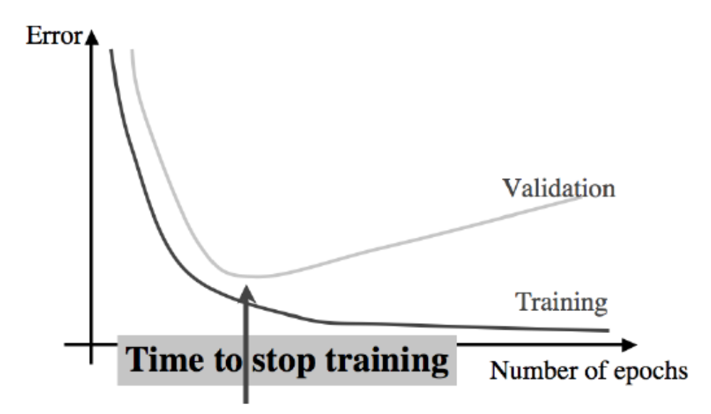
Generalization

Slide 61
Overfitting
As we have seen, the learning should be stopped at the minimum of the validation set error. At this point the net generalizes best. This is also known as Early Stopping.
We have also mentioned a guideline that data should be about10 times more than the number of weights.
But what happens when NN is over trained (i.e. with more training data)?
Well, it will try to model many more input data points including noise. This is called overfitting i.e. trying to best follow the training – next slide.

Slide 62
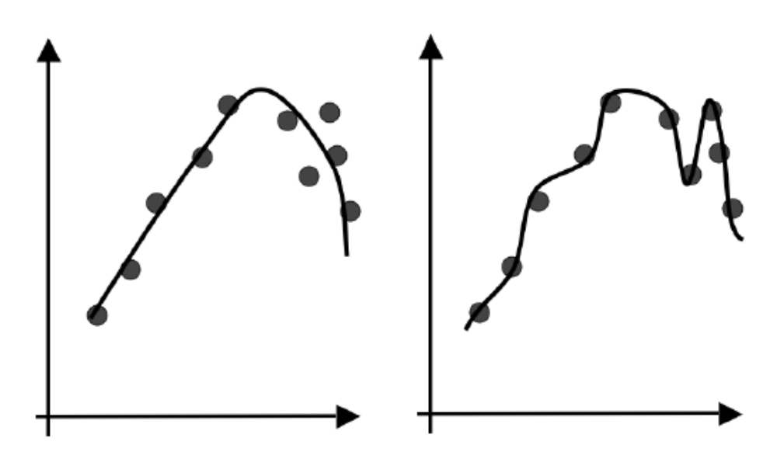
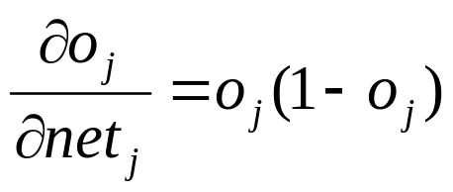
Overfitting (right) and Regular Learning (Left)
On the left of the figure the curve fits the overall trend of the data well (it has generalized to the underlying general function).
On the right it has memorized the training examples, including any noise component of them, so that is has overfitted the training data.

Slide 63
Overfitting / Overtraining & Undertraining
Best following training data (overfitting) means higher error rate on new unseen data i.e. poor learning (remember after Early stopping, validation error increases).
Obviously, poor learning means poor generalization or poor modeling.
How about undertraining? Well, then there will be no overfitting but the network will not learn the model well i.e. there will be more errors for unseen data (poor generalization).
Thus, neither over-training nor under-training is good.

Slide 64
Large Gap between ANN and Biological Learning
There is a Large Gap between ANN and Biological / Real Neuron as mentioned in Lecture 2.
Key differences are in:
  Network Architecture
  Feedback paths
  Learning rules
  Bias, Threshold Function
  Semantics (more on this later)
  and more

Slide 65
Yet NN is a Great Learning System
NN is still a Great Learning System given the fact that it does not do many things that neurons in our brain do.
NN is a mostly used learning system in ML, especially considering Deep Learning.
Further Improvements in NN will continue to make NN better and better; thus enabling to address more complex problems in ML.
It is a great opportunity for you to not only use NN but also try to improve it to get closer to human Learning capabilities!

